Slide 1
New Surfactants for Personal Care
Dennis Abbeduto, Personal Care Business Manager

Slide 2
New Products Covered Today
Cola®Teric CAHS Amphoacetate replacement with improved benefits
Cola®Teric OAB PEG-free, palm-free thickener
Cola®Teric CBS-UL Cocamidopropyl Hydroxysultaine with exceptionally light color
Cola®Mate LA-100 MB Dry powder surfactant for water-free formulations
RSPO Updates
Preservative Updates

Slide 3
Cola®Teric CAHS
Amphoacetate replacement with improved benefits

Slide 4
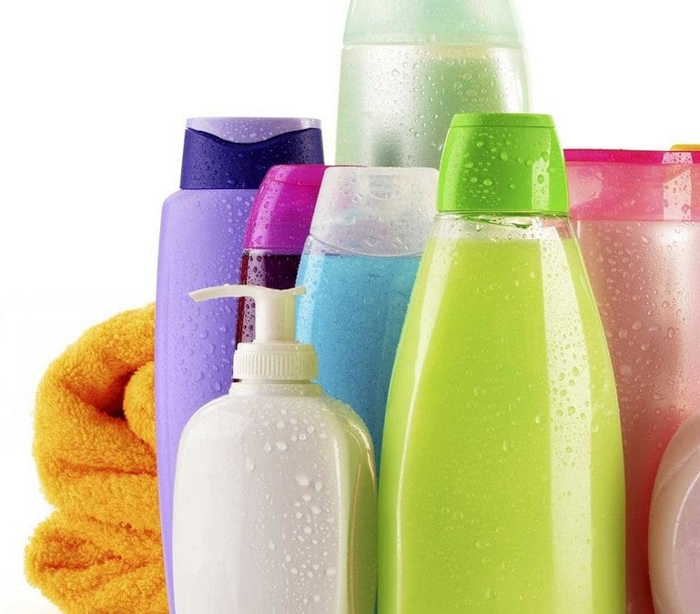
Improving Sustainability of Secondary Surfactants
New product development has been geared toward primary surfactants
Secondary surfactants, while generally naturally derived, still contain significant portions of petrochemical feedstocks
Up to 40% of most secondary surfactants can be petrochemical in origin
By utilizing the same intermediates as sultaines, we can produce amphoacetate analogs with higher biobased proportions
Additional properties can be improved
Higher solids
Lower irritation
Better compatibility with hard water and soaps
Remove Prop 65 ingredient (Dichloroacetic Acid)

Slide 5
Cola®Teric CAHS
INCI: Sodium Cocoamphohydroxypropylsulfonate
CAS: 85736-96-5
Listings: US (TSCA Exempt), China (IECSC)
Property | Characteristic
Appearance | Free flowing liquid
Color | Pale yellow
Odor | Faint fatty
Solids | 48%
Salt | 6%
pH, 10% aqueous | 7.5
Preservative | None
ISO 16128 | Pending biobased analysis

Slide 6
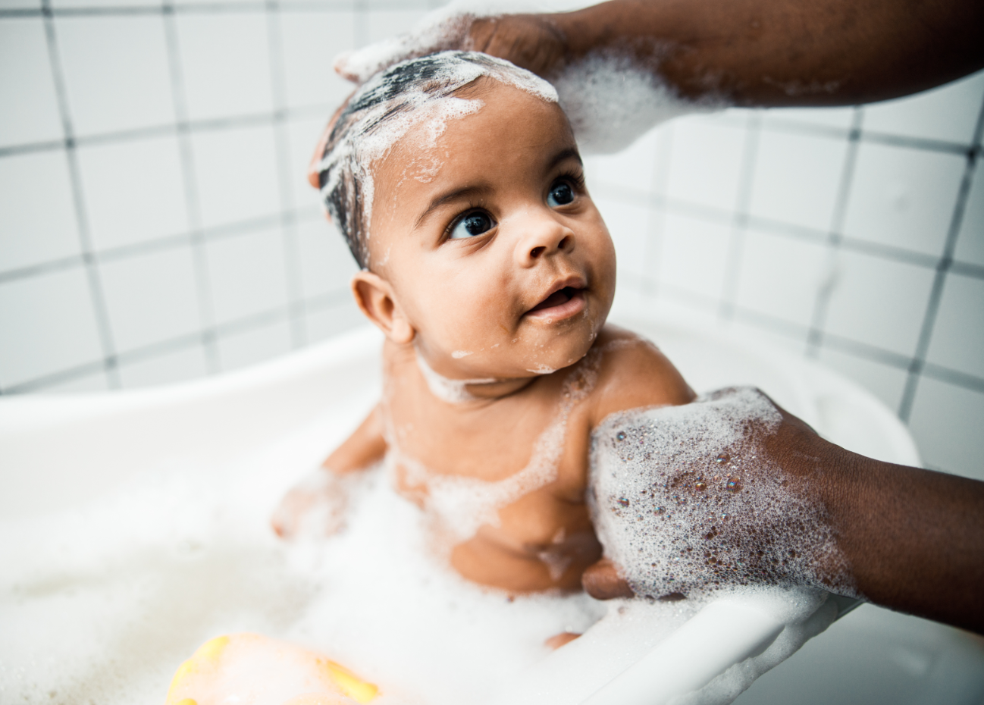
Cola®Teric CAHS Benefits
Sustainable secondary surfactant
High foam
Low color, odor
Fully amphoteric
Improved biobased content
Improved hard water compatibility
Improved soap dispersion
Higher solids than amphoacetate counterpart
Higher purity than amphoacetate counterpart
Excellent mildness
Draize Equivalent @ 4% solids = 6.1/Minimally Irritating

Slide 7
Foam Performance

Slide 8
Viscosity Performance
Ingredient | ColaTeric CAHS | Sodium Cocoamphoacetate
Water | 74.63 | 74.46
Colonial SLS | 10.00 | 10.00
Colonial SLES-2 | 10.00 | 10.00
ColaTeric CAHS | 3.87 | -
Sodium Cocoamphoacetate | - | 4.04
ColaLiquid DC | 1.50 | 1.50
Citric Acid 50% | qs to pH 6 | qs to pH 6

Slide 9
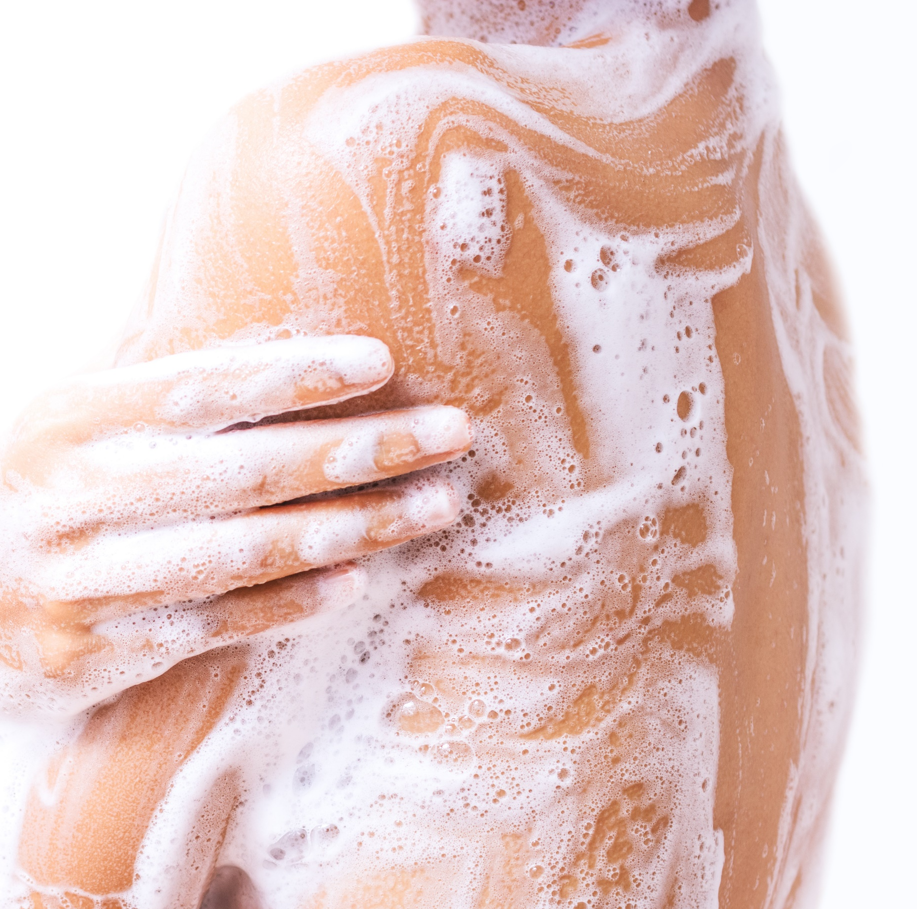
Cola®Teric CAHS Applications
Luxury body washes
Foam stabilization, viscosity boosting
Shampoos
Improved foam, viscosity boosting
Facial cleansers
Excellent skin feel
Wet wipes
Mild foaming with excellent feel
Micellar waters
Excellent detergency, low irritation
Baby washes
Low irritation, viscosity boosting

Slide 10
Cola®Teric CAHS in Formulation
5% AHA Facial Cleanser |  |  | # 2074
INCI Name | Trade Name | % | Function
Water | Water | qs to 100.00 | Carrier
Sodium C14-16 Olefin Sulfonate | Colonial AOS-40 UP | 36.50 | Primary anionic
Sodium Cocoamphohydroxypropylsulfonate | Cola®Teric CAHS | 12.00 | Irritation reduction, viscosity build
Cocamidopropyl Hydroxysultaine | Cola®Teric CBS | 1.50 | Viscosity build
Cocamidopropyl PG-Dimonium Chloride Phosphate | Cola®Lipid C | 1.50 | Skin conditioning, antimicrobial*
Lactic Acid | PURAC® HS 90 ¹ | 5.56 | AHA
Sodium Benzoate and Potassium Sorbate | Euxyl® K712 ² | 1.00 | Preservative
Fragrance | Sea Air & Lavender ³ | 0.20 | Fragrance
¹Corbion, ²Schülke and Mayr, ³Orchidia Fragrances
TYPICAL PROPERTIES Appearance: Clear, Viscous Liquid
pH 3.0 – 4.0
Viscosity 3,000 – 4,000 cP
Surfactant Solids 20.3 – 21.8%

Slide 11
Cola®Teric CAHS
Mild Amphoacetate Replacement with Improved Sustainability
INCI Name | Sodium Cocoamphohydroxypropylsulfonate
Global Clearances | US TSCA Exempt, China IECSC
Physical Form | Light colored liquid
Key Features | Replaces Cocoamphoacetate Higher solids Higher purity No Prop 65 Strong viscosity building Low irritation potential
Suggested Applications | Mild cleansers Wipes AHA/BHA facial cleansers
Certifications | ISO 16128 (Pending Certified Biobased Test)

Slide 12
Cola®Teric OAB
PEG-free, Palm-free Thickener

Slide 13
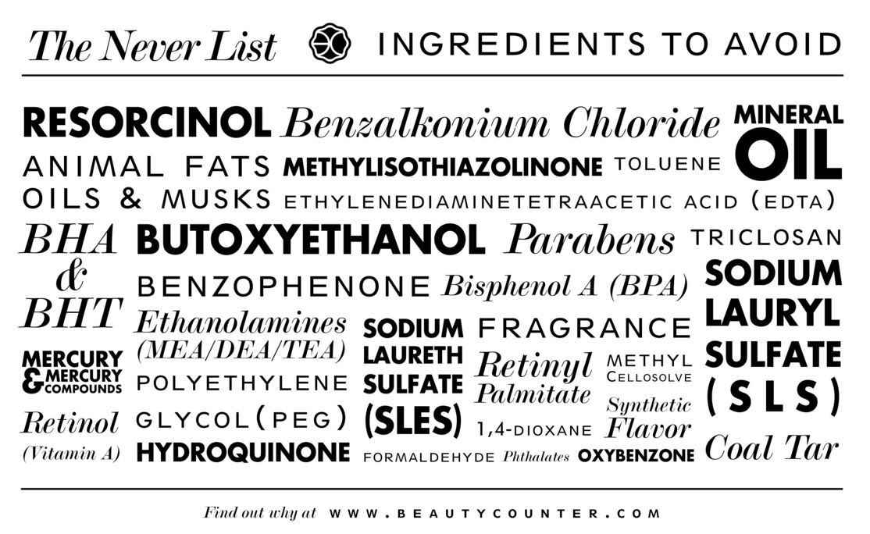
Goodbye PEG!
Ethoxylated surfactants are on their way OUT
Clean beauty brands
Clean beauty retailers
Global dioxane restrictions
New York State dioxane restrictions
< 2 ppm by end of 2022
< 1 ppm by end of 2023
Sulfate-free products are IN
BUT hard to thicken!

Slide 14
Cola®Teric OAB
INCI: Oleamidopropyl Betaine
CAS: 25054-76-6
Listings: US (TSCA), Canada (DSL), Australia (AICIS), China (IECSC/IECIC), Philippines (PICCS), New Zealand (NZIoC)
Property | Characteristic
Appearance | Free flowing, lightly viscous liquid
Color | Amber
Odor | Faint fatty
Solids | 35%
Salt | 4%
pH | 7
Preservative | MCI/MI

Slide 15
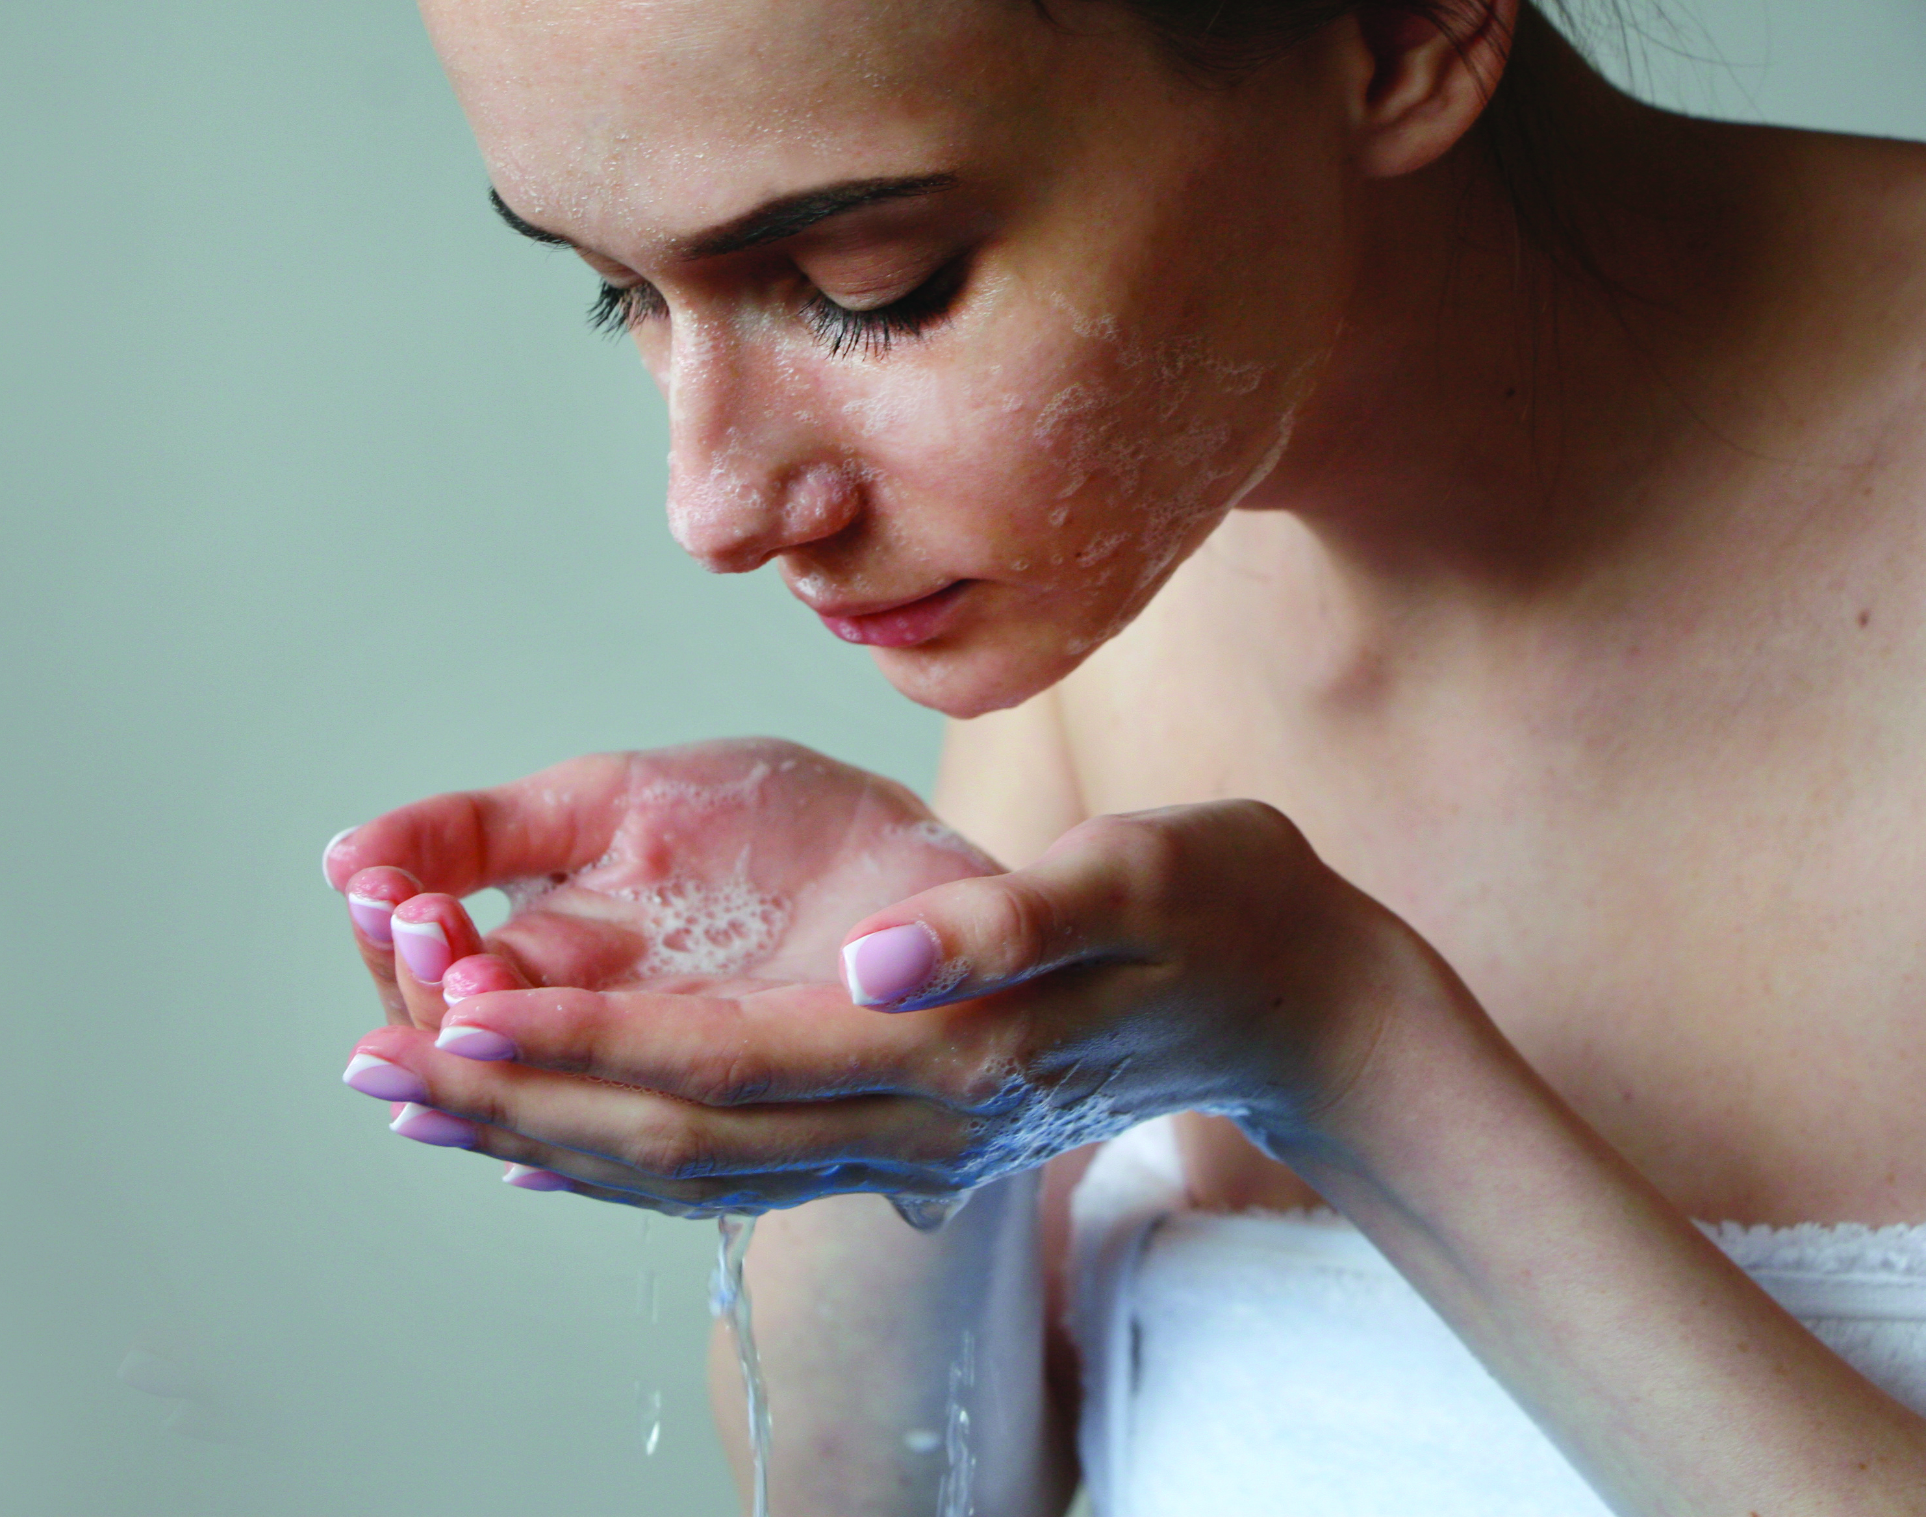
Cola®Teric OAB Benefits
Thickener for surfactant systems
PEG-free
Palm-free
Low irritation potential
Emollient feel
Effective at low use (1-3%)
Easy to use liquid

Slide 16
ColaTeric OAB Performance
Ingredient | INCI | A | B | C | D | E | F
Water |  | 75.0 | 74.0 | 73.0 | 72.1 | 74.0 | 74.0
Colonial SLS | Sodium Lauryl Sulfate | 10.0 | 10.0 | 10.0 | 10.0 | 10.0 | 10.0
Colonial SLES-2 | Sodium Laureth Sulfate | 10.0 | 10.0 | 10.0 | 10.0 | 10.0 | 10.0
ColaTeric COAB | Cocamidopropyl Betaine | 5.0 | 5.0 | 5.0 | 5.0 | 5.0 | 5.0
ColaTeric OAB | Oleamidopropyl Betaine | - | 1.0 | 2.0 | 3.0 | - | -
ColaMid CMA | Cocamide MEA | - | - | - | - | 1.0 | -
ColaMid CMPA | Cocamide MIPA | - | - | - | - | - | 1.0
 | Citric Acid | qs to pH 6

Slide 17
ColaTeric OAB Performance

Slide 18
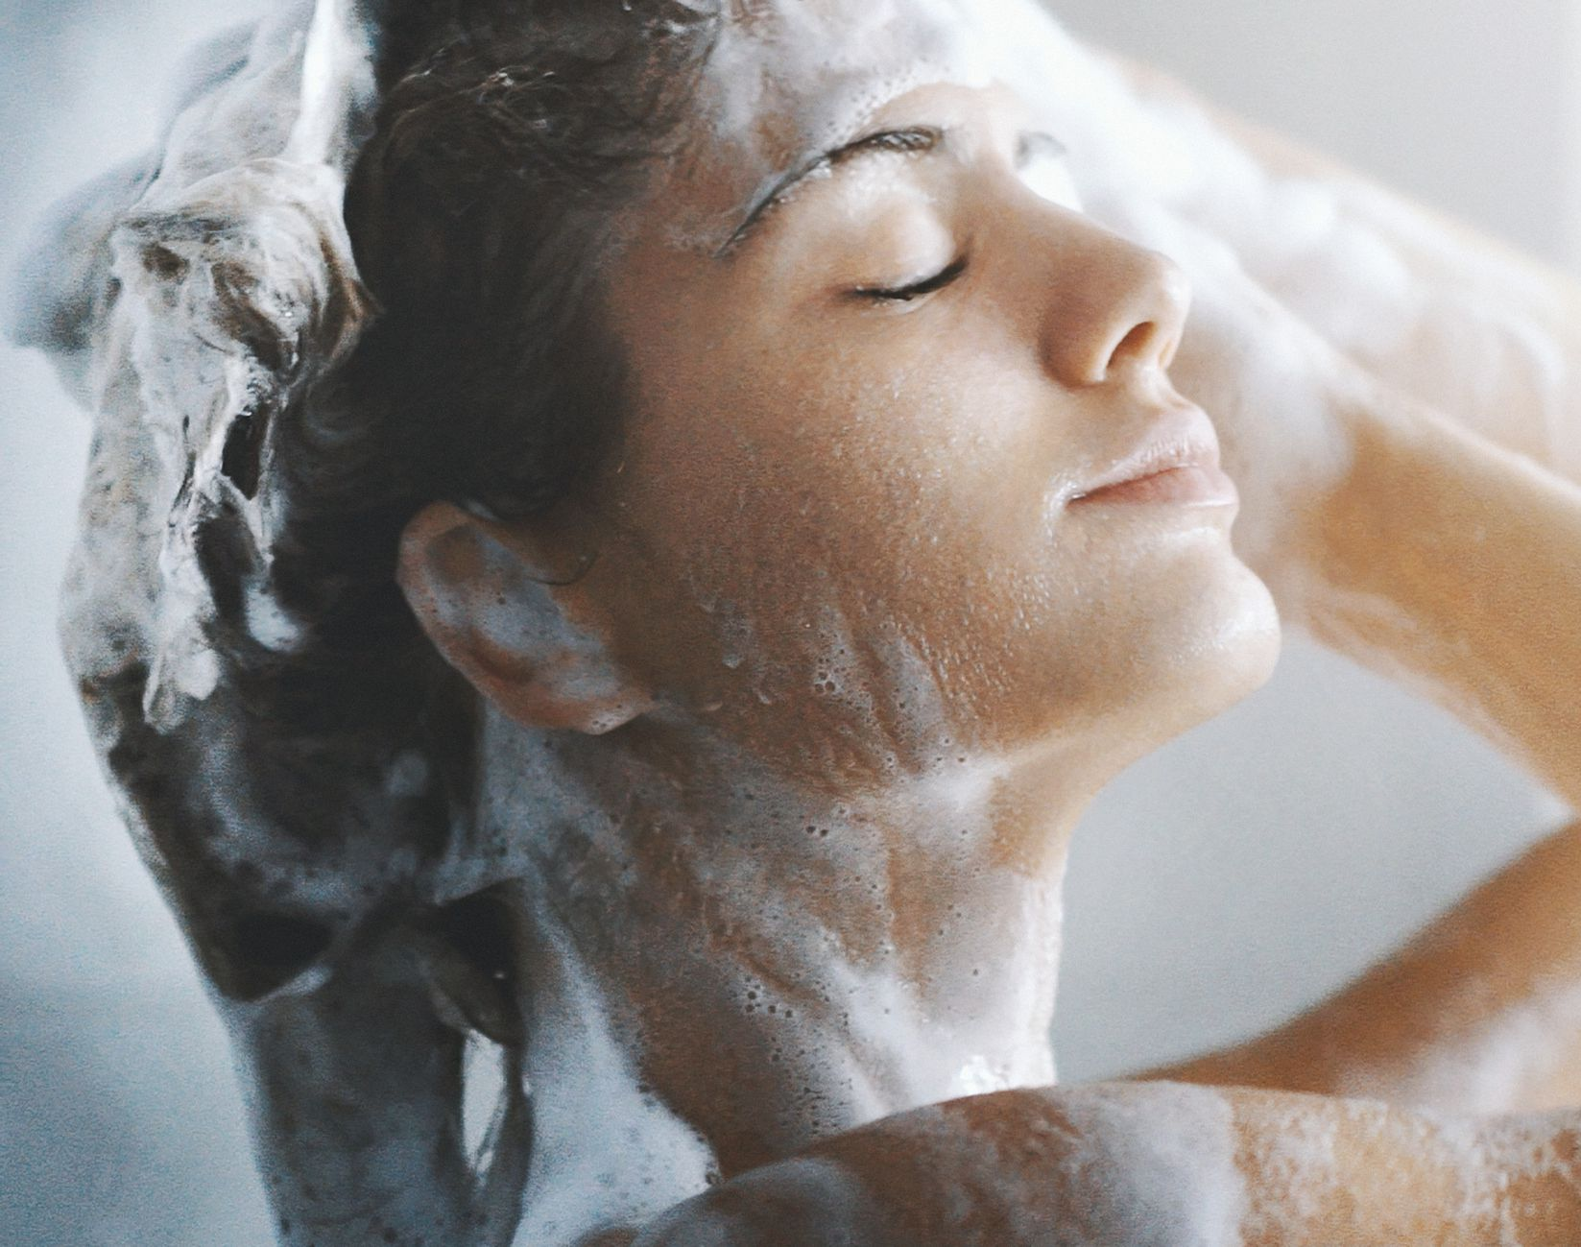
Cola®Teric OAB Applications
All types of liquid cleansers
Viscosity boosting
Denser foam
Refatting
Lower irritation
Reduced salt to build viscosity
Syndet bars
Refatting
Lower irritation
Denser foam

Slide 19
Cola®Teric OAB in Formulation
Grapefruit Body Wash |  |  | # 2072
INCI Name | Trade Name | % | Function
Water | Water | qs to 100.00 | Carrier
Sodium C14-16 Olefin Sulfonate | Colonial AOS-40 UP | 12.00 | Primary anionic
Disodium Laurylglucosides Hydroxypropyl Citrate | Suga®Citrate L1C | 6.00 | Ultra-mild primary anionic
Cocamidopropyl Betaine | Cola®Teric COAB | 7.00 | Secondary amphoteric
Oleamidopropyl Betaine | Cola®Teric OAB | 2.00 | Viscosity build
Hydroxypropyl Bis-Hydroxyethyldimonium Chloride | Cola®Moist 200 | 3.00 | Humectant
Sodium Chloride | Sodium Chloride | 1.25 | Thickener
Sodium Benzoate and Potassium Sorbate | Euxyl® K712 ¹ | 1.00 | Preservative
Fragrance | Uplifting Grapefruit ² | 0.20 | Fragrance
Citric Acid | Citric Acid, 50% | qs to pH 5.0 – 5.5 | pH Adjuster
¹Schülke & Mayr, ²Orchidia Fragrances
TYPICAL PROPERTIES Appearance: Clear, Viscous Liquid
pH 5.0 – 5.5
Viscosity 5,000 – 8,000 cP
Surfactant Solids 11.8 – 12.8%

Slide 20
Cola®Teric OAB in Formulation
Clean & Calm Face Wash |  |  | # 2073
INCI Name | Trade Name | % | Function
Water | Water | qs to 100.00 | Carrier
Decyl Glucoside, Cocamidopropyl Hydroxysultaine, Cocamidopropyl Betaine, Cocamide MIPA, Disodium Laureth Sulfosuccinate, Disodium Lauryl Sulfosuccinate | Cola®Det EQ-18 | 30.00 | Surfactant blend
Oleamidopropyl Betaine | Cola®Teric OAB | 2.00 | Viscosity build
Sodium Benzoate and Potassium Sorbate | Euxyl® K712 ¹ | 1.00 | Preservative
Fragrance | Sea Air & Lavender ² | 0.20 | Fragrance
Citric Acid | Citric Acid, 50% | qs to pH 5.0 – 5.5 | pH Adjuster
¹Schülke & Mayr, ²Orchidia Fragrances
TYPICAL PROPERTIES Appearance: Clear, Viscous Liquid
pH 5.0 – 5.5
Viscosity 2,000 – 3,000 cP
Surfactant Solids 13.3 – 14.2%

Slide 21
Cola®Teric OAB
PEG-free Thickener for Foaming Cleansers
INCI Name | Oleamidopropyl Betaine
Global Clearances | Global, REACH <1 Tonne
Physical Form | Amber Liquid
Key Features | Palm-free, PEG-free thickener for surfactant systems Easy to use liquid form Low irritation potential Improves feel of products after rinsing
Suggested Applications | Shampoos, body washes, gel cleansers Viscosity boosting Skin conditioning Lower irritation
Certifications | None

Slide 22
Cola®Teric CBS-UL
Cocamidopropyl Hydroxysultaine with Ultra Light Color

Slide 23
Cola®Teric CBS-UL
INCI: Cocamidopropyl Hydroxysultaine
CAS: 68139-30-0
Listings: USA (TSCA), Canada (DSL), EU (REACH), Australia (AICS), China (IECSC/IECIC), Philippines (PICCS), New Zealand (NZIOC), Taiwan (NECI)
Property | Characteristic
Appearance | Clear liquid
Color | Nearly colorless, 100APHA Maximum
Odor | Faint fatty
Solids | 50%
Salt | 7%
pH | 7
Preservative | None

Slide 24
Cola®Teric CBS-UL in Formulation
Face Wash |  |  | # 2070
INCI Name | Trade Name | % | Function
Water | Water | qs to 100.00 | Carrier
Disodium Laurylglucosides Hydroxypropyl Citrate | Suga®Citrate L1C | 15.00 | Ultra-mild primary surfactant
Disodium Lauryl Sulfosuccinate | Cola®Mate LA-40 | 7.00 | Foam boosting co-surfactant
Babassuamidopropyl Hydroxysultaine | Cola®Teric BBS | 7.00 | Viscosity build
Cocamidopropyl Hydroxysultaine | Cola®Teric CBS-UL | 5.00 | Viscosity build
Cocamidopropyl PG-Dimonium Chloride Phosphate | Cola®Lipid C | 0.50 | Skin conditioning, antimicrobial*
Hydroxypropyl Bis-Hydroxyethyldimonium Chloride | Cola®Moist 200 | 3.00 | Humectant
Fragrance | Fragrance ¹ | 0.15 | Fragrance
Benzyl Alcohol and Ethylhexylglycerin and Tocopherol | Euxyl® K 900 ² | 0.70 | Preservative
¹Orchidia Fragrances, ²Schülke & Mayr
TYPICAL PROPERTIES Appearance: Clear, Viscous Liquid
pH 5.0 – 5.5
Viscosity 2,000 – 4,000 cP
Surfactant Solids 16.4 – 17.6%

Slide 25
Cola®Teric CBS-UL
Coconut Oil-Derived Sultaine
INCI Name | Cocamidopropyl Hydroxysultaine
Global Clearances | Globally approved
Physical Form | Clear Liquid
Key Features | Exceptionally light color High solids without additives Unique sustainability aspect No added preservatives Improved soap dispersion and hard water foaming vs betaines No Prop 65 components
Suggested Applications | Facial cleansers Hand and body washes Shampoos Syndet bar products
Certifications | ISO 16128 (0.76)

Slide 26
Cola®Mate LA-100 MB
Dry Powder Surfactant for Water-Free Formulations

Slide 27
Blue Beauty?
Look out Green Beauty and Clean Beauty, here comes Blue Beauty!
Blue Beauty is all about water usage and packaging impact in the environment
Dry form and solid form products are key
Reduced packaging
Reduced water usage
Reduced environmental impact
Dry and solid cleansing products are everywhere!
Shampoo powders (not dry shampoo)
Cleansing tablets
Cleansing pods
Refillable bottles using dissolvable refill forms
Shampoo bars (really just syndet bars)

Slide 28
Cola®Mate LA-100 MB
INCI: Disodium Lauryl Sulfosuccinate
CAS: 68139-30-0
Listings: USA (TSCA), Canada (DSL), EU (REACH), Australia (AICS), China (IECSC/IECIC), Philippines (PICCS), New Zealand (NZIOC), Taiwan (NECI)
Property | Characteristic
Appearance | Free flowing powder
Color | White
Odor | Faint fatty
Solids | 95+%
pH | 6
Preservative | None

Slide 29
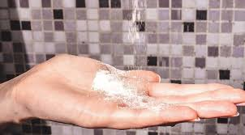
Cola®Mate LA-100 MB Benefits
Dry powder surfactant
No added drying aids
High flash foam
Low irritation potential
Quickly disperses and foams in water
Colorless powder
Combine with other powders, starches
Can be used in hot-pour and pressed solids
Excellent color stability

Slide 30
Cola®Mate LA-100 MB Applications
Powder or pressed tablet cleansers
Primary surfactant
High foam
Good cleansing
Low irritation
Syndet bars
Improved mildness
Improved hard water tolerance
Dispersed solids within films
Nearly soluble in glycols
No clumping in glycols

Slide 31
Cola®Mate LA-100 in Formulation
Charcoal Scalp Restoring Scrub |  |  | # 4043
INCI Name | Trade Name | % | Function
Cocos Nucifera (Coconut) Oil | Coconut Oil | 22.00 | Carrier
Cannabis Sativa Seed Oil | Hemp Seed Oil ¹ | 4.00 | Carrier
Glyceryl Laurate | Colonial Monolaurin | 2.00 | Stability, antimicrobial
Disodium Lauryl Sulfosuccinate | Cola®Mate LA-100 MB | 8.00 | Foam
Melaleuca Alternafolia (Tea Tree) Leaf Oil | Tea Tree Oil ² | 0.25 | Fragrance
Sucrose | Sugar | 41.75 | Exfoliant
Sea Salt and Activated Charcoal | Black Hawaiian Sea Salt ³ | 22.00 | Exfoliant
¹Jedwards, ²Orchidia Fragrances, ³SaltWorks
TYPICAL PROPERTIES Appearance: Black exfoliating scrub

Slide 32
Cola®Mate LA-100 in Formulation
Detox & Soothe Powder Shampoo |  |  | # 1052
INCI Name | Trade Name | % | Function
Sodium Laurylglucosides Hydroxypropylsulfonate | Suga®Nate 160 Dry | 25.00 | Mild primary anionic
Disodium Lauryl Sulfosuccinate | Cola®Mate LA-100 | 25.00 | Foam-boosting anionic
Maltodextrin | Maltrin QD® M500 ¹ | 26.00 | Filler
Kaolin | Kaolin Clay USP ² | 10.00 | Filler
Aloe Barbadensis (Aloe Vera) Leaf | Biochemica® BioVera 200X Aloe ³ | 0.50 | Soothing additive
Vitis Vinifera (Grape) Seed Oil | Grape Seed Oil ⁴ | 13.00 | Fine powder control
Fragrance | Fragrance ⁵ | 0.50 | Fragrance
¹Grain Processing Corporation, ²Charkit, ³Hallstar, ⁴Jedwards International, ⁵Orchidia Fragrances
TYPICAL PROPERTIES Appearance: Dry, White Powder
pH (5% Aqueous): 6.5 – 7.5

Slide 33
Cola®Mate LA-100 in Formulation
Hand-Pressed Shampoo Bar |  |  | # 1056
INCI Name | Trade Name | % | Function
Sodium Coco-Sulfate | Colonial SCS | 64.50 | Primary anionic in needle form
Disodium Lauryl Sulfosuccinate | Cola®Mate LA-100 | 15.00 | Secondary anionic in powder form
Zea Mays (Corn) Starch | Farmal™ CS 3757 ¹ | 5.00 | Filler
Vitis Vinifera (Grape) Seed Oil | Grape Seed Oil ² | 3.00 | Processing
Water | Water | 9.50 | Processing
Sodium Grapeseedamidopropyl PG-Dimonium Chloride Phosphate | Cola®Lipid GS | 2.00 | Binding, conditioning
Fragrance | Fragrance ³ | 1.00 | Fragrance
Dye | Dye | qs | Color
¹Ingredion, ²Jedwards International, ³Orchidia Fragrances
TYPICAL PROPERTIES Appearance: Bar with visible SCS needles

Slide 34
Cola®Mate LA-100 in Formulation
Bubble Bath Bar |  |  | # 4044
INCI Name | Trade Name | % | Function
Sodium Bicarbonate | Sodium Bicarbonate | 48.00 | Fizz
Citric Acid | Citric Acid | 24.00 | Fizz
Magnesium Sulfate | Epsom Salt ¹ | 9.00 | Luxury additive
Sodium Chloride | Himalayan Pink Salt (fine grain) ¹ | 9.00 | Luxury additive
Disodium Lauryl Sulfosuccinate | Cola®Mate LA-100 | 5.00 | Foam
Vitis Vinifera (Grape) Seed Oil | Grape Seed Oil ² | 4.00 | Processing
Fragrance | Fragrance ³ | 1.00 | Fragrance
Dye | Dye | qs | Color
¹SaltWorks, ²Jedwards International, ³Orchidia Fragrances
TYPICAL PROPERTIES Appearance: Pressed Powder Bar

Slide 35
Cola®Mate LA-100 MB
Dry Powder Surfactant
INCI Name | Disodium Lauryl Sulfosuccinate
Global Clearances | Global
Physical Form | White powder
Key Features | Dry powder surfactant for waterless cleansers RSPO certified natural palm feedstock Low irritation potential in formulation High foam performance Disperses easily in water for optimal performance
Suggested Applications | Syndet bars Powder to foam cleansers Pressed solid cleansers Anhydrous “pod” cleansers
Certifications | RSPO Mass Balance, ISO 16128 0.76

Slide 36

RSPO Updates
2021 will be the year of RSPO!
ColaTeric L-32 MB
ColaTeric SLAA MB
ColaMate DSLS MB
ColaMate DSLS-BA MB
ColaMate LA-40 MB
ColaFax CPE-K MB
And MORE!

Slide 37
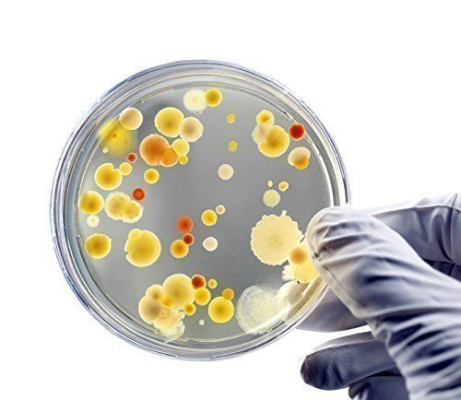
Preservative Updates
Pressure to revise/update/remove preservatives continues
Out: MCI/MI in any leave-on application
On the bubble: Phenoxyethanol in any leave-on application
ColaTeric CB is now free of added preservatives
ColaMoist 200 change pending
ColaMate RM change pending
ColaMate LA-40 change pending

Slide 38
Thank you!
Dennis Abbeduto: dennis@colonialchem.com
Product TDS/SDS/Formulations: https://www.colonialchem.com
Formula Girls Podcast: https://apple.co/3dUq5fh

